Slide 1
Assessing current issues in ART - from a provider perspective Dr Richard Fisher Fertility Associates

Slide 2
HART Act 2004
Now 12 years
Based on treatment of infertility couples
social change
PGS
PGD
preservation
high level of expectation

Slide 3
Current Issues
Donor recruitment
Import/export
Recompense
Funding
Information keeping

Slide 4
What is infertility? NICE
Failure to conceive after regular unprotected intercourse for 2 years in the absence of known reproductive pathology.
RCOG press 2004

Slide 5
What is infertility? WHO
Failure to conceive a pregnancy after 1 years contraceptive free intercourse (under 34 yrs)
Failure to conceive a pregnancy after 6 months contraceptive free intercourse if female is over 36
(Cooper – Human Reprod. Update 16)

Slide 6
What is infertility?
An emotional experience which sometimes requires a physical solution

Slide 7
Social model of infertility
Community
Time
Gender

Slide 8
Social model of infertility
Is normal acceptable?

Slide 9
Monthly fecundity by age
Years %
25 25
30 20
35 16
37 11
40 6
42 4
44 2
Source: Fertility Associates

Slide 10
When should I seek advice (Biological clock)

Slide 11
Donor Recruitment
No longer students
Identifiable at FA since 1991
New model
socially aware
interest of recipients, donors, children are better managed
International or local

Slide 12
HART Act 2004
Principles:
donor offspring should be made aware of their genetic origins and be able to access information about those origins;
the different ethical, spiritual, and cultural perspectives in society should be considered and treated with respect.

Slide 13
HART Act 2004
Commercial supply of human embryos or human gametes prohibited:
No person may give or receive, or agree to give or receive, valuable consideration for the supply of a human embryo or human gamete.
Every person commits an offence who contravenes subsection (1) and is liable on conviction to imprisonment for a term not exceeding 1 year or a fine not exceeding $100,000, or both.
Section 13(2): amended, on 1 July 2013, by section 413 of the Criminal Procedure Act 2011 (2011 No 81).

Slide 14
Valuable consideration
History
Expenses /financial assistance
Change in UK
Change in NZ legislation for kidney donors (cost neutrality)

Slide 15
What do we expect from donors:
Sperm:
Initial contact
Trial semen analysis
Information session with donor co-ordinator
Fill out Health & Lifestyle questionnaire
Fill out non ID Information
Blood tests
Appointment with Dr for history & examination
Counselling appointment and consent
Semen donation at clinic x 10
Follow up blood tests
Travel time for all the above
= Approx. 20 hours

Slide 16
What do we expect from donors:
Egg:
Complete online application
Phone consultation with donor co-ordinator
Initial blood tests & Partner blood tests
Health & Lifestyle questionnaire
Smear test / swabs if required
Consultation with Dr including scan
Complete non ID information
1st counselling session
Additional counselling if required (incl. joint counselling)

Slide 17
What do we expect from donors:
Egg: cont.
Review of recipient profiles
Nurse appointment for information and drug teaching
Consents
Second blood tests
Second Health & Lifestyle questionnaire
Start IVF cycle – drugs, blood tests, scans
Egg retrieval
Continuing post operation contact
Review consultation with Dr
Travel for all the above
= Approx. 30-40 hours

Slide 18
HART Act 2004
Purposes: The Act has the following purposes:
to secure the benefits of assisted reproductive procedures, established procedures, and human reproductive research for individuals and for society in general by taking appropriate measures for the protection and promotion of the health, safety, dignity, and rights of all individuals, but particularly those of women and children, in the use of these procedures and research;
to establish a comprehensive information-keeping regime to ensure that people born from donated embryos or donated cells can find out about their genetic origins.

Slide 19
HART Act 2004
Providers and Registrar-General must keep information about donors:
A provider must, in accordance with this section, keep all information about a donor obtained or accept under section 47 in relation to any donated embryo or a donated cell.
In any case where the use of the donated embryo or the donated cell results in the birth of a living donor offspring, the provider must give the information to the Registrar-General on the earlier of the following events:
the expiry of 50 years after the date of that birth:
the provider ceasing to be a provider in circumstances where there is no successor provider.
The Registrar-General must keep indefinitely all information given under subsection (2).

Slide 20
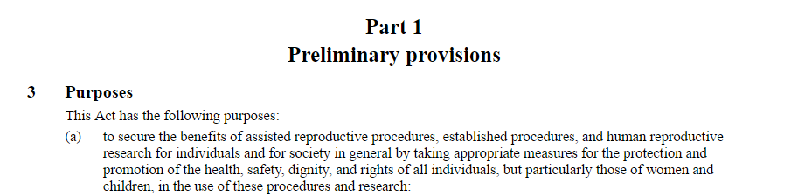
Does ACART and ECART have a role in Education?
Age related pregnancy rates
IVF pregnancy rates
Information about donor gametes
Egg freezing

Slide 21
Egg Freezing - If frozen eggs were as good as fresh:
Bank at 30, try naturally at 35
85% chance of having a baby naturally
15% of infertility, having a batch of frozen eggs increased the IVF baby rate from 40% to 48%
Bank at 30, try naturally at 40
60% chance of having a baby naturally
40% of infertility, having a batch of frozen eggs increased the IVF baby rate from 22% to 48%
Bank at 35, try naturally at 40
60% chance of having a baby naturally
40% of infertility, having a batch of frozen eggs increased the IVF baby rate from 22% to 40%

Slide 22
Egg Freezing - If frozen eggs were as good as fresh:
Bank at 30, try naturally at 43
40% chance of having a baby naturally
60% of infertility, having a batch of frozen eggs increased the IVF baby rate from 8% to 48%
Bank at 35, try naturally at 43
40% chance of having a baby naturally
60% of infertility, having a batch of frozen eggs increased the IVF baby rate from 8% to 40%

Slide 23
How many Eggs do I need?
Several studies demonstrate how many eggs required per baby (for a 70% chance)
25-34 required 10 oocytes
35-37 required 14 oocytes
38-40 required 25 oocytes
41-42 required ?50 oocytes

Slide 24
Gender Selection
With PGS gender is known but not reported.
Whose right to know?
What if only one?
When is information available

Slide 25
Legislation because we can
 | Infertile | Fertile
Legislated | yes | no
Regulated | yes | no
Consented | yes | no

Slide 26
Embryo disposal
Withdrawal from storage and thawing
Donation to another couple
Why not donation for research and training with appropriate regulation?

Slide 27
Public Funding
How do we cope with new technologies?
Will we have 2 levels of care?
PGS – cost of repeat transfers - burden of loss
Fertility Preservation

Slide 28
Public Funding
ESHRE Benchmark 1,500 cycles/million POP
NZ ∼ 700/million
UK NICE Guidelines 3 cycle < 40
1 cycle 40-42
NZ Up to 2 cycles < 40
Subject to CPAC criteria
Australia Unlimited access - copayments

