Slide 1
SURROGACY: IS NEW ZEALAND’S LAW IN NEED OF REFORM?
Assoc Prof Debra Wilson
University of Canterbury

Slide 2
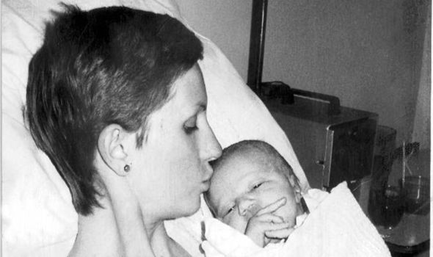
History of surrogacy regulation

Slide 3
The phases of surrogacy regulation
Jurisdiction | First phase | Second phase | Third phase
UK | Surrogacy Arrangements Act 1985 | Human Fertilisation and Embryology Act 1990, 2008 | Parliamentary debates 2016 Law Commission 2016
Aus Federal |  | SCAG Guidelines | Surrogacy Matters Report 2016
Victoria | Infertility Medical Procedures Act 1984 | Assisted Reproductive Treatment Act 2008
Queensland | Surrogate Parenthood Bill1988 | Surrogacy Act 2009
South Australia | Family Relationships Amendment Act 1988 | Statutes Amendment (Surrogacy) Act 2009 | Family Relationships (Surrogacy) Amend Act 2015
Tasmania | Surrogacy Contracts Act 1993 | Surrogacy Act 2012
ACT | Substitute Parent Agreements Act 1994 | Bills in 1996, 2000 Parentage Act 2004
NSW | Assisted Reproductive Technology Act 2003 | Surrogacy Act 2010
WA |  | Surrogacy Act 2007 | Parliamentary Debates 2015
Canada Federal | Bills 1996, 2002 | Bill 2003, Assisted Human Reproduction Act 2004 | Private Members Bill 2014
New Zealand | HART Act 2004

Slide 4
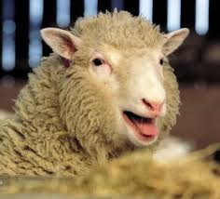
The new zealand experience: LEGISLATION
1996 Human Assisted Reproductive Technology Bill introduced (Yates Bill)
1998 Assisted Human Reproduction
Bill introduced (Government Bill)
2004 Health Committee consideration of
both Bills
2004 HART Act enacted

Slide 5
The new zealand experience: ECART
Year | Approved | Conditional Approval | Approved with Recommendation | Declined | Deferred | Total
2005 | 2 | 4 | 0 | 2 | 4 | 12
2006 | 13 | 4 | 0 | 1 | 0 | 18
2007 | 12 | 4 | 0 | 2 | 1 | 19
2008 | 13 | 3 | 1 | 0 | 1 | 18
2009 | 10 | 4 | 2 | 0 | 3 | 19
2010 | 20 | 1 | 3 | 0 | 5 | 29
2011 | 8 | 0 | 1 | 2 | 0 | 11
2012 | 14 | 1 | 1 | 0 | 1 | 17
2013 | 11 | 2 | 0 | 0 | 3 | 16
2014 | 11 | 9 | 0 | 0 | 2 | 22
2015 | 18 | 2 | 0 | 0 | 5 | 25
2016 (may) | 3 | 1 | 0 | 0 | 1 | 5
TOTAL | 135 | 35 | 8 | 7 | 26

Slide 6
new zealand experience: ADOPTION APPLICATIONS
Year | International | Domestic | Total
2003 | 1 | 0 | 1
2007 | 0 | 1 | 1
2009 | 1 | 1 | 2
2010 | 1 | 0 | 1
2011 | 1 | 1 | 2
2012 | 3 | 1 | 4
2013 | 1 | 3 | 4
2014 | 2 | 3 | 5
2015 | 3 | 2 | 5
2016 (May) | 1 | 0 | 1

Slide 7
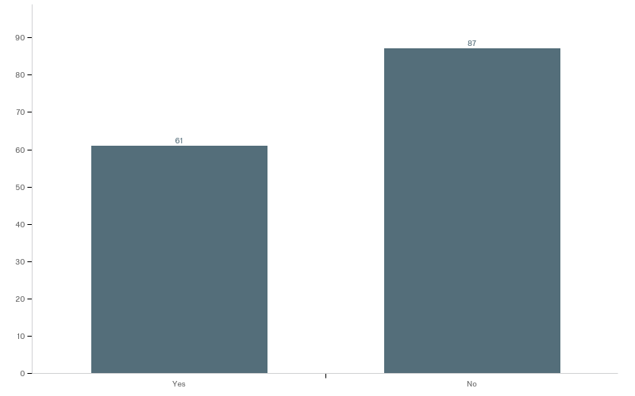
New zealand experience: empirical
700 lawyers identifying as specialising in family, child, surrogacy or adoption law on NZ Law Society website
Approximately 150 responses (survey still open)
Q2 - Have you had any inquiries in relation to surrogacy?

Slide 8
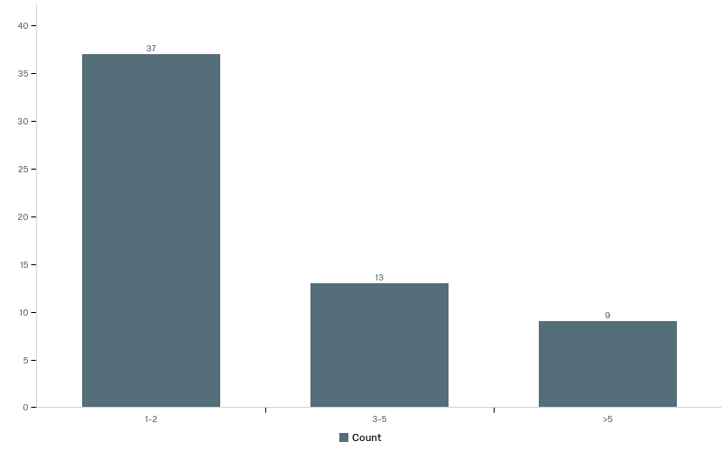
New zealand experience: empirical
Approximately how many inquiries in relation to surrogacy have you had?

Slide 9
New zealand experience: empirical

Slide 10
New zealand experience: empirical

Slide 11
CURRENT
ISSUES IN
SURROGACY

Slide 12
ALTRUISTIC OR COMMERCIAL SURROGACY?
New Zealand
Re KR [2011] NZFLR 429
“These are policy considerations that are not within the role of this Court to impose… My role is to determine this particular application in the light of its unique factual circumstances”
Re SCR [2012] NZFC 5466
“I am satisfied the surrogacy arrangement cannot be described as a “commercial surrogacy
arrangement”.
“reasonable expenses”
United Kingdom
Canada

Slide 13
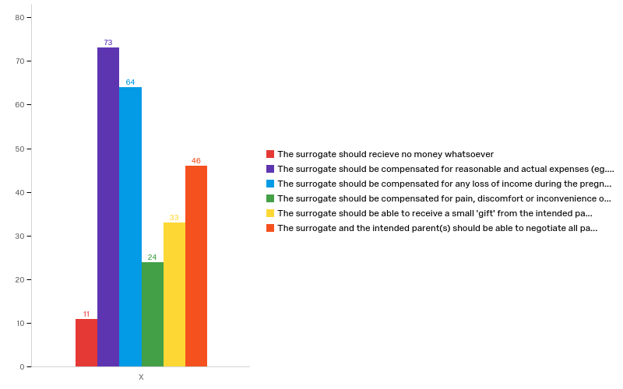
ALTRUISTIC OR COMMERCIAL SURROGACY?
Q22 - S 14(1) HART Act prohibits commercial surrogacy (with the exception of payments direct to doctors, clinics, or lawyers). Do you think that payments to the surrogate should be permitted?.

Slide 14
Criminal sanctions?
Australia: Dudley v Chedi
France: ‘Aurore’
Italy: Paradiso and Campanelli
Cambodia: Tammy Davis-Charles

Slide 15
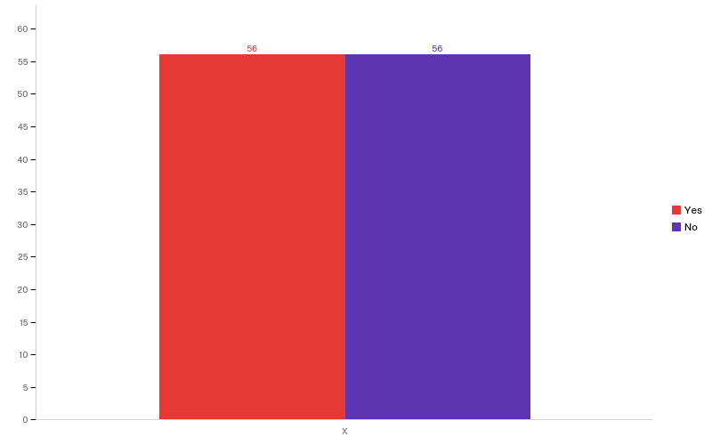
Q23 - S 14(5) HART Act states that any breach of the prohibition on commercial surrogacy is a criminal offence. Do you think that this remain a criminal offence?

Slide 16
PARENTAGE ?
Gestational v genetic v intentional model of parentage?
Laborie v France
Requirements to transfer parentage: adoption or specific order?
Re A [2015] EWHC 911

Slide 17
Advertising
Advertising for surrogate or intended parents
A and B [2016] EWFC 34
“yet another example of the difficulties that arise out of the unregulated market in surrogacy in this jurisdiction.”
Advertising for crowdfunding
Landon Haley (2012)
GiveForward: $65 million raised in 2013
GoFundMe: $150 million raised in 2014
‘Triplings’ GiveALittle $28,948 in 2016

Slide 18
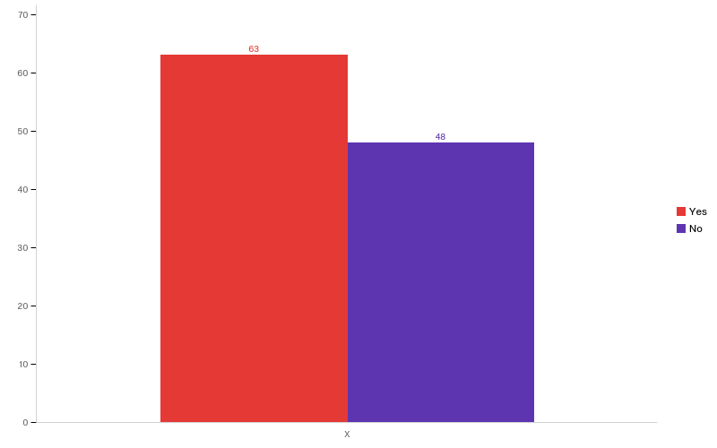
Q24 - S 15 HART Act prohibits advertising in relation to surrogacy. Do you think that advertising should be permitted?

Slide 19
CONCLUSION
“any reform will need to be very carefully considered. There are many factors to be considered”
“I think we need to tread carefully in this area”
“The law badly needs tidying and catching up to the 21st Century”
“The situation is not going to go away. Perhaps it is time to regulate the process which would aid safety”
“not black and white” / “to me it is very black and white”

