Slide 1
Genetic screening in NZ fertility clinics
Dr Juliet Taylor
Clinical geneticist
Genetic Health Service New Zealand (Northern Hub)

Slide 2
Pre-conceptual reproductive carrier screening
We are all estimated to be carriers for at least three clinically severe childhood recessive disorders
HGSA/RANZCOG position statement “All couples intending to have children, or who are pregnant, should be made aware of the availability of carrier screening for more common genetic disorders (CF, SMA, Fragile X)”. This recommendation not widely followed.
Carrier screening in public system (genetic services primarily) – currently offered when there is a family history dependent on carrier frequency (prevalence of condition) or in certain ethnic groups (South East Asians (haemoglobinopathies), Ashkenazi Jews (range of disorders)
Usually if carrier frequency is high but varies between genetic services
Difficulties with carrier screening
Possibilities of identifying variant of uncertain significance in unrelated partner – complicates counseling
Timing – often accessed in early pregnancy, which increases anxiety and reduces options if both partners found to be carriers
Cost

Slide 3
Pre-conceptual reproductive carrier screening
Now offered in some private fertility clinics
Couples cover cost
Varying numbers of conditions can be tested for e.g. CF, Fragile X, SMA (Prepair https://www.vcgs.org.au/tests/prepair) versus hundreds of (Counsyl https://www.counsyl.com/
Pre and post test counseling essential to explain limitations of testing e.g. residual risk
Equity of access –
User pays testing not readily accessible if seen in public system
Only being offered to select group seen by fertility providers
No plans for implementing population screening

Slide 4
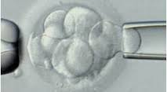
PGD technique

Slide 5
Accepted uses of PGD – HART act 2004
Familial single gene and chromosomal disorders
Must have ≥25% risk and where “there is evidence that the future individual may be seriously impaired as a result of the disorder”
Sex determination for familial sex-linked disorders
≥25% risk, “serious” and no specific test for that mutation is available
eg. X-linked intellectual disability syndrome

Slide 6
Preimplantation genetic diagnosis (PGD)
Pre-implantation genetic diagnosis in New Zealand
Which genetic conditions are eligible for PGD ?
Who determines whether a condition is eligible?
The role of the clinical genetic service in the provision of this publically funded process.
The effect of resource constraints in the provision of PGD in New Zealand.

Slide 7
Role of clinical genetics service
All couples undergoing PGD in NZ must be seen by Clinical Geneticists
Provide genetic counseling so couples understand their risk and their reproductive options
Provide non-directive counselling about PGD
Role in decision regarding serious disorder
Notes:
On the most part, we see couples prior to them being seen by a fertility provider and we make the referral to the PGD provider. Ensure that couple understand their risk and all of their reproductive options. Give overview of PGD process, discussion regarding success rates etc.
We play a role in determining whether a condition is likely to result in the serious impairment of the future individual. In this respect in our region we play a gatekeeper role in the flow of patients we decide are eligible for PGD.

Slide 8
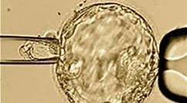
PGS technique

Slide 9
Accepted uses of PGS
Pre-implantation genetic screening (PGS) – not publically funded
diagnosis of non-familial chromosomal disorders (aneuploidy testing) where:
(i) the woman is of advanced reproductive age
(ii) the woman has had recurrent implantation failure or recurrent miscarriage

Slide 10
Pre-implantation genetic screening (PGS)
Screening for large chromosomal imbalances (implantation failure, early miscarriage, viable trisomies e.g. T21)
Who is being offered this technology?
Recurrent pregnancy loss
Recurrent implantation failure
Advanced maternal age
?Everyone
What is the evidence to support use of PGS?
Not currently covered in public system but offered by private fertility providers

Slide 11
Preimplantation Genetic Screening (PGS)
Conflicting evidence
Improves implantation rate and live birth rate (Dahdouh, 2015. Fertil Steril 2015; 104:1503–1512. Meta-analysis 3 trials included
Intention to treat analysis. Among all attempts at PGS or expectant management among recurrent pregnancy loss (RPL) patients, clinical outcomes including pregnancy rate, live birth (LB) rate and clinical miscarriage (CM) rate similar. (Murugappan 2016; Human Reproduction 31:1668–1674)
PGS decreased chances of live birth in association with IVF. National improvements in live birth and miscarriage rates reported with PGS in older women are likely the consequence of favorable patient selection biases. (Kushnir 2016. Fertil Steril 106: 75–9)
Concern of accuracy of diagnosis and high rate of false-positives. Gleicher 2016. Reprod Biol Endocrinol doi 10.1186/s12958-016-0193-6

Slide 12
Limitations
Mosaicism – some embryos considered unsuitable for transfer develop into healthy pregnancies (Greco 2015. NEJM 373:2089–90).
?Couples choice to transfer non-euploid embryo
Pre and post test counseling essential
Different platforms – inconsistent results. Discordance in results seen in published reports (Tortoriello 2016. J Assist Reprod Genet 33:1467–1471)

Slide 13
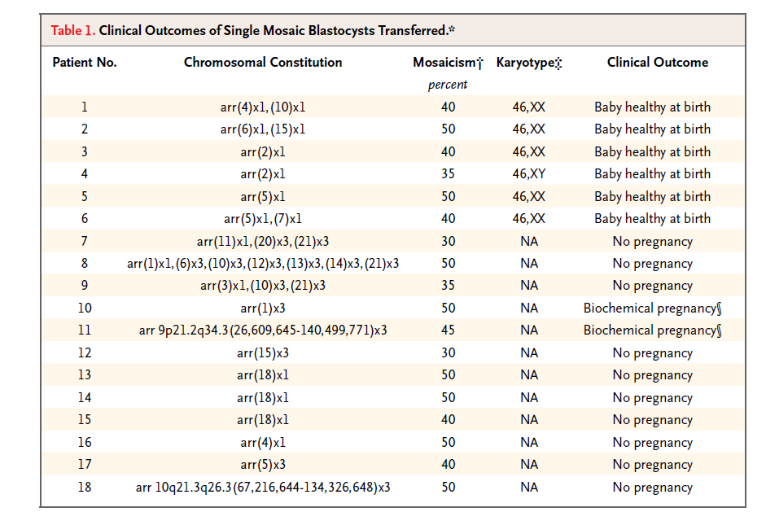
“Healthy Babies after Intrauterine Transfer of Mosaic Aneuploid Blastocysts” NEJM 373:21

Slide 14
PGS in NZ
Different providers offering testing done by different laboratories/companies - different technologies.
?Uptake
?Counseling provided
?Should PGS be offered outside of clinical trials before body of evidence substantial enough to support benefit

Slide 15
HFEA UK – patient information
“What is my chance of having a baby with PGS?
Because a large proportion of patients who receive PGS are older patients, patients with a history of miscarriages or other indications and also because many of the embryos produced are not suitable for transfer to the womb, the success rate varies considerably depending on the patient’s individual circumstances.
Various studies have questioned whether or not PGS is effective at increasing the chance of having a live birth. There is a lack of evidence that having a treatment cycle with PGS will increase your chances of having a baby compared to having a treatment cycle without PGS.
More robust randomised controlled trials are needed before a decision can be made either way.
Centres are required to validate the use of PGS (i.e. demonstrate there is evidence) for each category of patients they offer it to (e.g. advanced maternal age, recurrent implantation failure, recurrent pregnancy loss and male factor infertility)”

Slide 16
Who should decide whether a disorder causes serious impairment?
Clinicians - Clinical geneticists, Fertility specialists, specialists involved in managing condition
Affected family
Society
Appointed committee
Notes:
In NZ the determination of a serious disorder falls to clinicians – clinical geneticists and fertility specialists. We often question whether this is best approach and wonder who is the best group to decide this? The family ?, society?, an appointed committee? In practice our discussions regarding the appropriateness of a condition for PGD generally take place at our weekly team meetings either prior to or after a couple have a consultation. We have found over the years that our opinions/decisions might change based on who was present at the meeting depending on the stance different individuals take. There may also be regional differences in NZ with respect to what conditions get referred. Overall we feel that a more standardised approach would likely to be more transparent and fairer.
In some cases the decision is easy. For conditions with a severe phenotype, congenital onset or associated with shortened lifespan, significant morbidity
The more difficult decisions often arise from conditions with a variable age of onset – childhood or adulthood, variable severity, variable penetrance meaning the proportion of those with the genotype who develop the phenotype and conditions that do not affect lifespan or intellect but affect quality of life or require ongoing treatment

Slide 17
Human Fertilization and Embryology Authority (HFEA) - UK
List of disorders that have been accepted as appropriate for PGD http://guide.hfea.gov.uk/pgd/
Conditions individually assessed for suitability
Open to feedback from all sectors during submission process
Notes:
In the UK, the HFEA has compiled a list of conditions accepted for PGD as a result of an application process for individual conditions. A condition can be submitted for assessment and the process is open to feedback from all sectors. The list covers over 250 conditions so is quite extensive. There are conditions on the list that we would not refer couples for PGD for in NZ.
?Role for similar in NZ or perhaps national committee where difficult cases discussed

Slide 18
UK legislation: preimplantation testing
PGS: is permitted to establish if the embryo has a gene/chromosome/mitochondrion abnormality that may affect its capacity to result in a live birth.
PGD: permitted when there is a particular risk that the embryo may have a gene/chromosome abnormality to determine if it has that abnormality or any other gene/chromosome/mitochondrion abnormality:
any gene/chromosomal condition tested for must be associated with a significant risk of developing a serious physical or mental disability/illness. (HFEA list)

Slide 19
Genetic counseling in the future
Known single gene disorders – familial variation
New genetic technologies will increase complexity
Accuracy and reliability of DNA technologies
Understanding what is ‘normal’ at the level of the embryo
Understanding the significance of mosaic disorders
Predicting outcomes of embryo ‘treatment’

